Slide 1




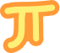



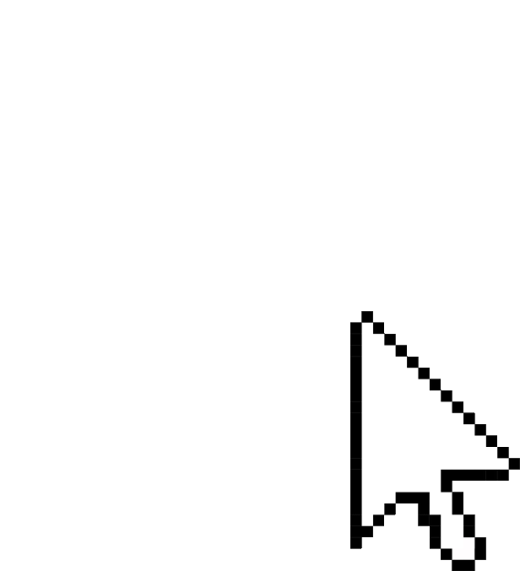


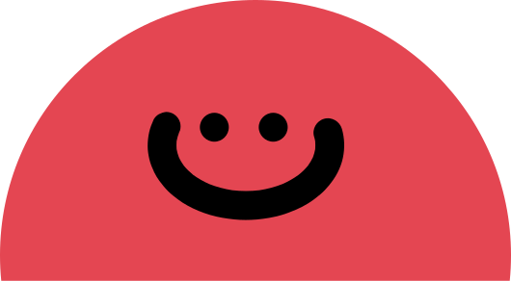
Motion Detection
Hand Detection + Sign Language detection +AI virtual Board +AI Music Media Controller

Slide 2

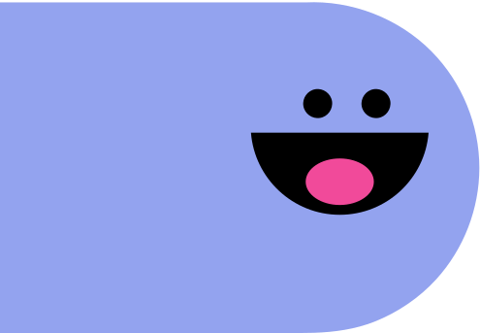
Motion detection
Hand detection is a specific application of object detection and computer vision technology, where the primary goal is to identify and locate human hands within an image or video stream. Hand detection is used in a wide range of applications, including gesture recognition, sign language interpretation, virtual reality, human-computer interaction, and more. It is a crucial component of systems that involve natural and intuitive interaction with computers or devices.
Description
Motion detection is a technology or technique used to identify and track the movement of objects or changes in an environment. It is commonly employed in various applications, including security systems, computer vision, robotics, and more. The primary goal of motion detection is to detect and analyze the motion of objects or regions within a captured video stream or a series of images.

Slide 3

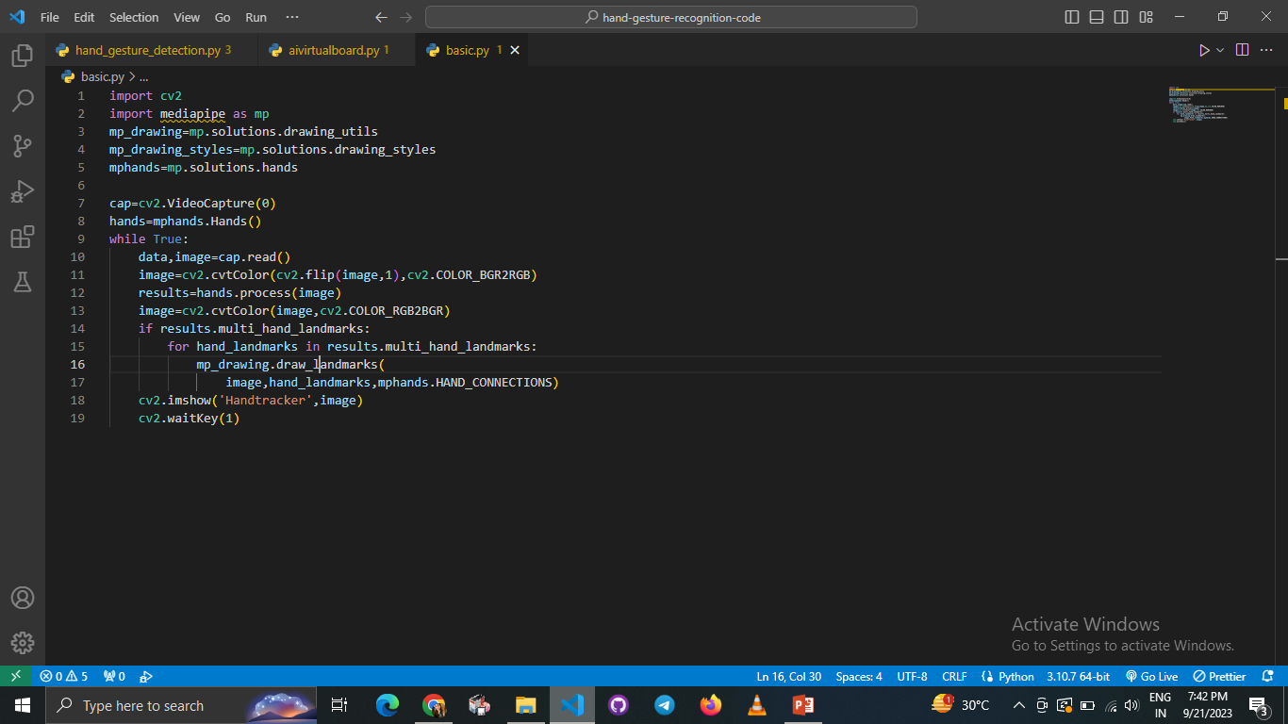
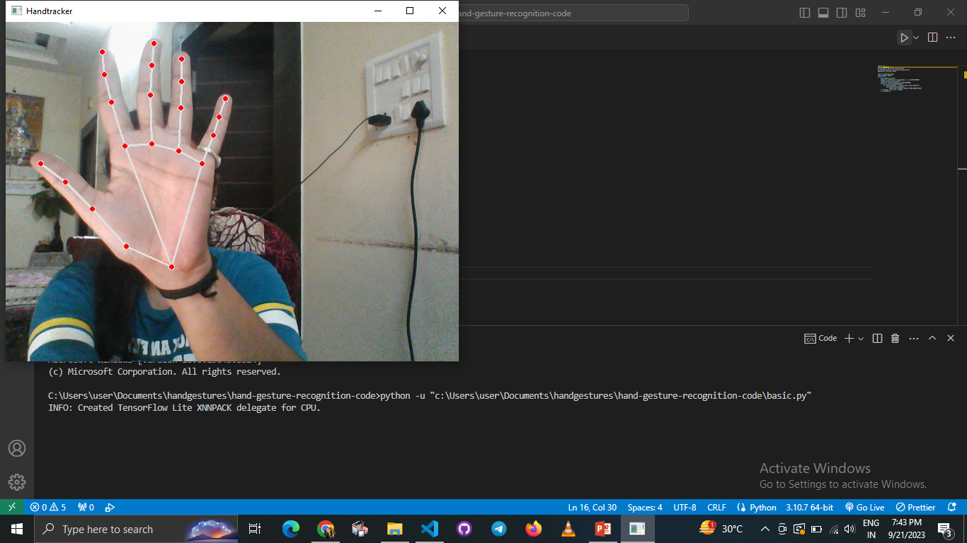


Slide 4
LIBRARIES USED
OpenCV is a huge open-source library for computer vision, machine learning, and image processing. It can process images and videos to identify objects, faces, or even the handwriting of a human.
MediaPipe is a customizable machine learning solutions framework developed by Google. It is an open-source and cross-platform framework, and it is very lightweight. MediaPipe comes with some pre-trained ML solutions such as face detection, pose estimation, hand recognition, object detection, etc.
TensorFlow is an open-source library for machine learning and deep learning developed by the Google brains team. It can be used across a range of tasks but has a particular focus on deep neural networks.
Neural Networks are also known as artificial neural networks. It is a subset of machine learning and the heart of deep learning algorithms. The concept of Neural networks is inspired by the human brain. It mimics the way that biological neurons send signals to one another. Neural networks are composed of node layers, containing an input layer, one or more hidden layers, and an output layer.
NumPy is a general-purpose array-processing package. It provides a high-performance multidimensional array object and tools for working with these arrays. It is the fundamental package for scientific computing with Python. It is open-source software

Slide 5

Use Cases
Gaming: Gesture recognition allows gamers to control characters, perform in-game actions, and provide immersive gameplay experiences without the need for physical controllers.
Virtual Reality (VR) and Augmented Reality (AR): Hand gestures can be used to interact with virtual environments, control objects, and navigate within VR and AR applications. Users can gesture to select, grab, and manipulate virtual objects.
Touchless Interfaces: Gesture-based interaction can replace traditional touch-based interfaces, reducing the risk of spreading germs in public touchscreens, such as ATMs, kiosks, and elevators
Sign Language Translation: Hand gesture recognition can assist in real-time translation of sign language to text or speech, making communication more accessible for the hearing-impaired.
Rehabilitation Therapy: Hand gesture recognition systems can be used in physical therapy and rehabilitation exercises to monitor and guide patients' movements.
Gesture-Controlled Infotainment Systems: Drivers and passengers can use hand gestures to control car audio systems, navigation, and other in-vehicle functions without taking their hands off the steering wheel.

Slide 6
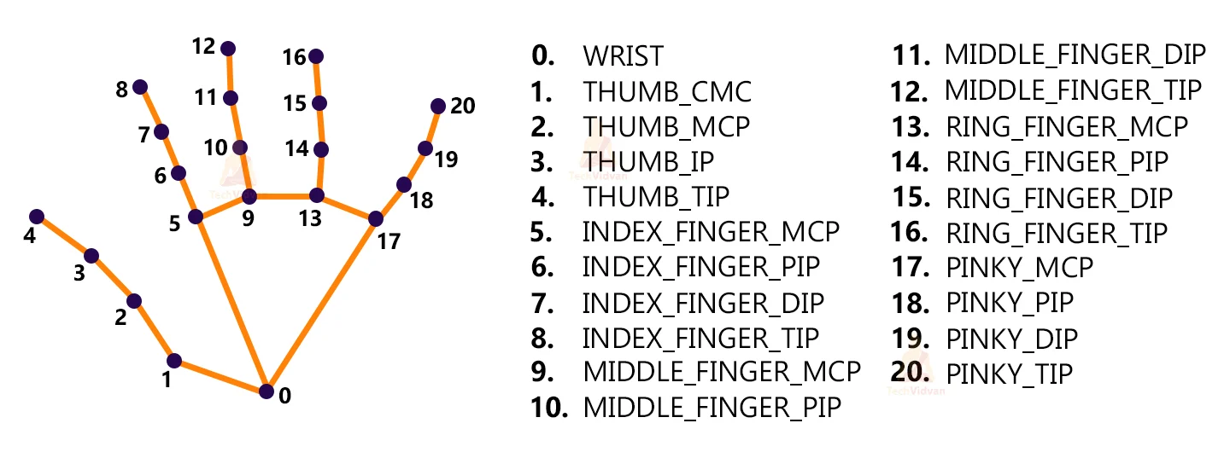
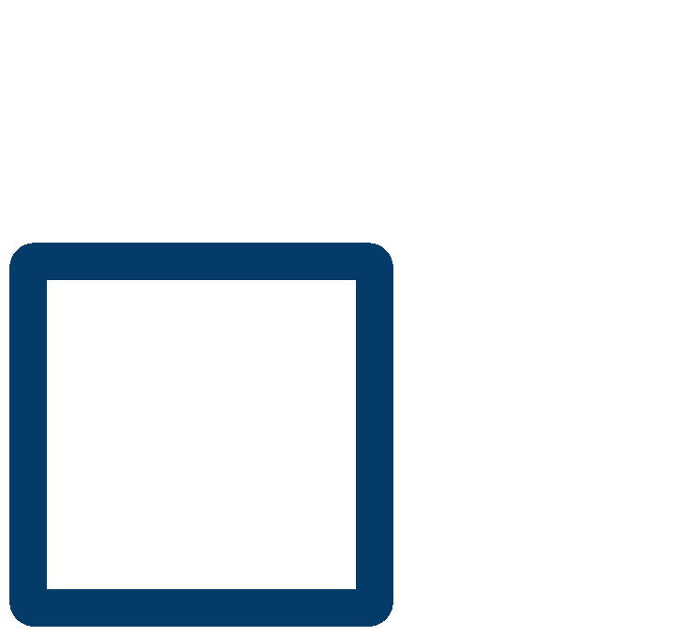
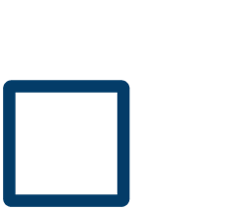
Import necessary packages.
.
.
Initialize models.
.
Read frames from a webcam.
.
Detect hand keypoints.
Recognize hand gestures.
.

Slide 7
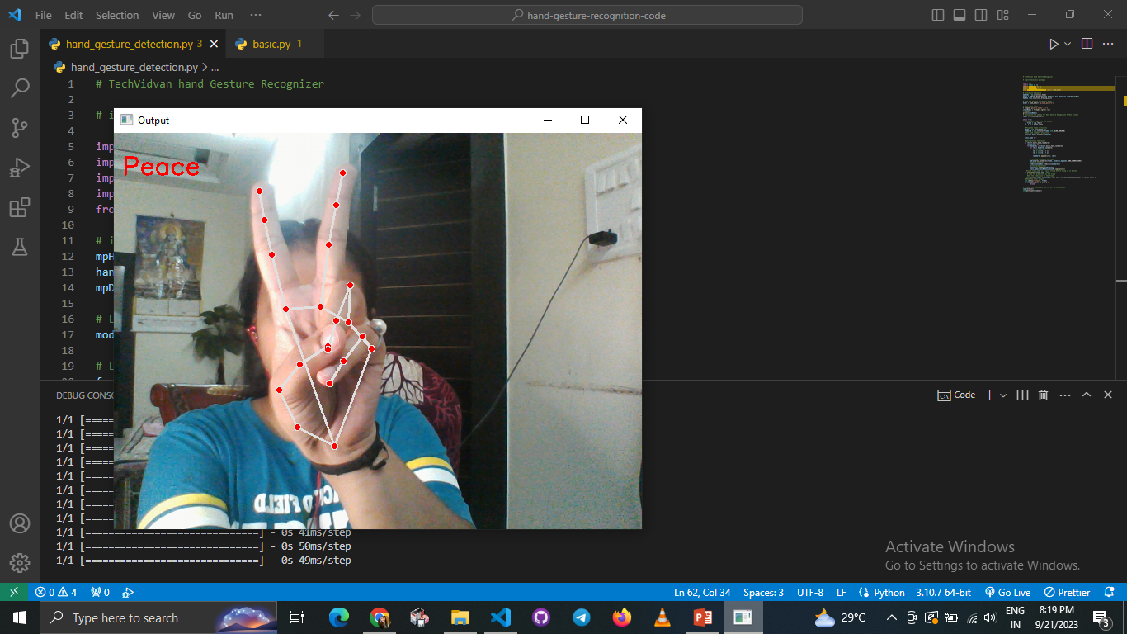
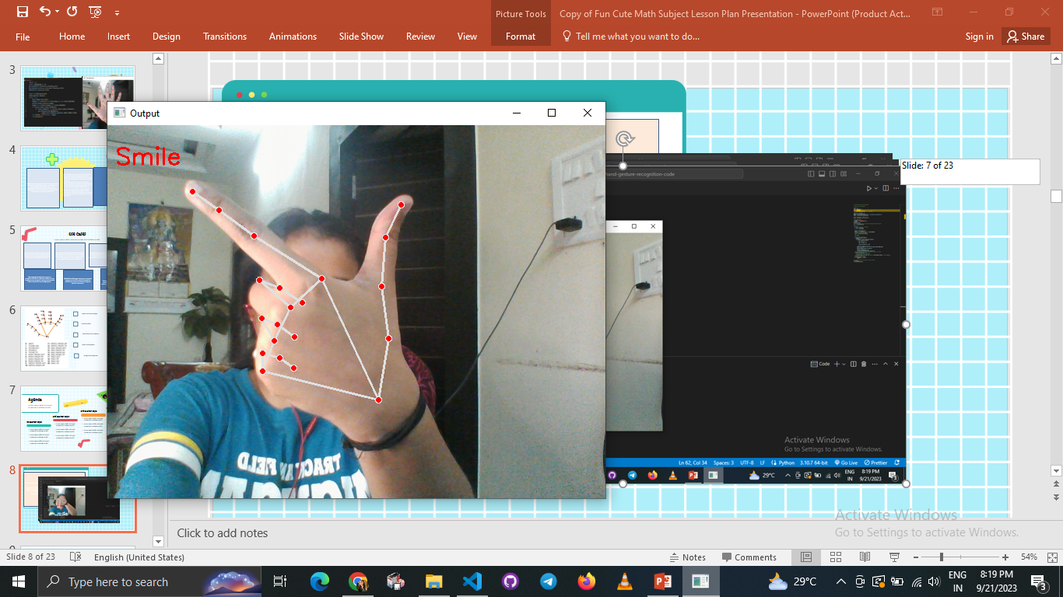
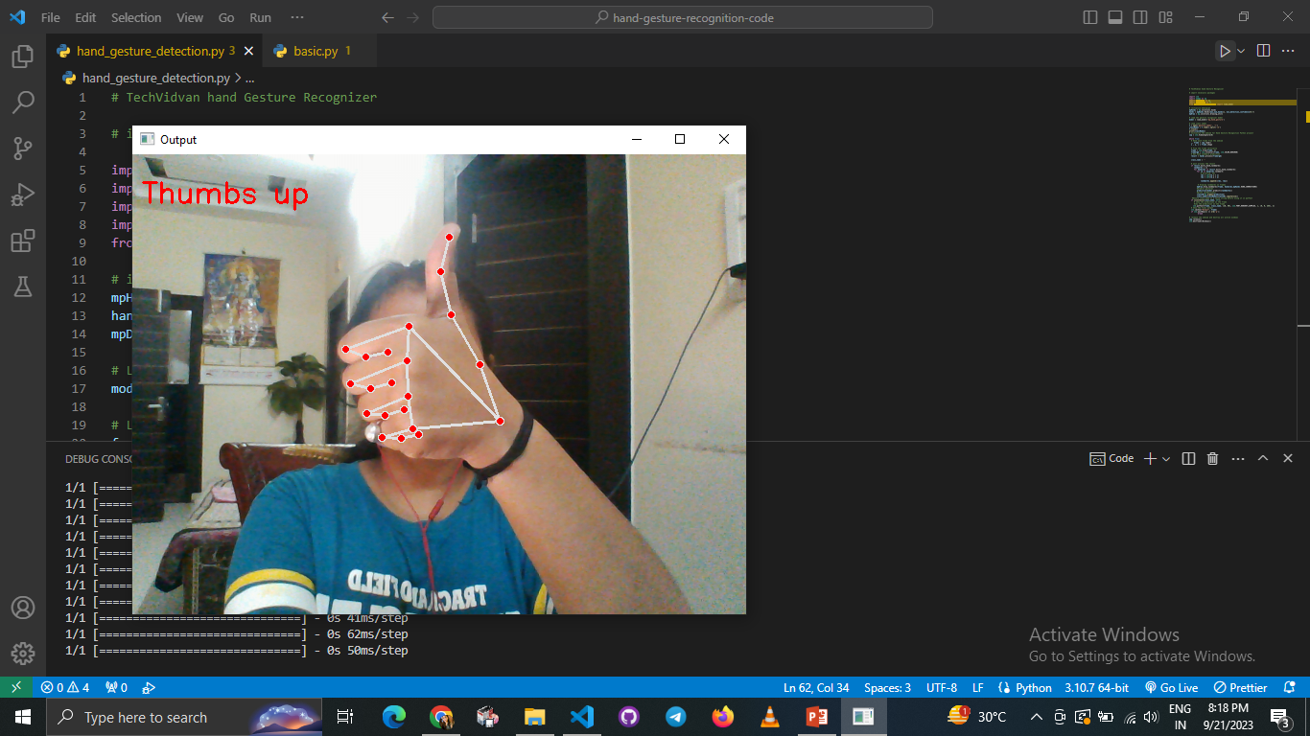
MediaPipe works with RGB images but OpenCV reads images in BGR format. So, using cv2.cvtCOLOR() function we convert the frame to RGB format.
Using mpHands.Hands method we configured the model. The first argument is max_num_hands, that means the maximum number of hand will be detected by the model in a single frame. MediaPipe can detect multiple hands in a single frame, but we’ll detect only one hand at a time in this project.
Np.argmax() returns the index of the maximum value in the list
Then using the cv2.putText function we show the detected gesture into the frame

Slide 8
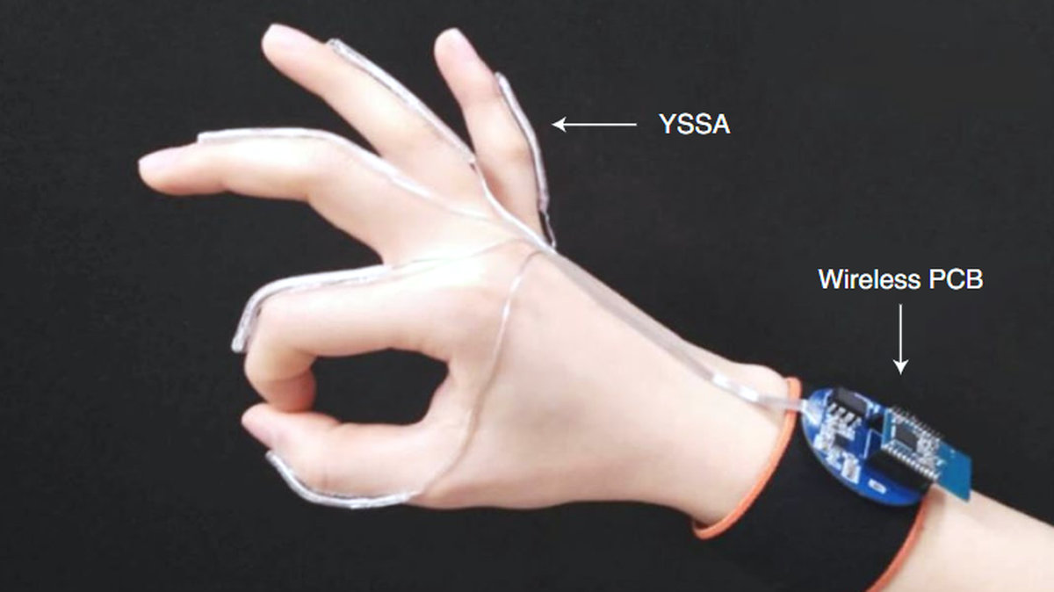
ADVANTAGES /FUTURE SCOPE
Artists and performers can use hand gestures to control music, lighting, and visual effects during live performances.
Interactive Learning: Gesture-based educational applications can engage students in interactive learning experiences, such as virtual science experiments or historical simulations.
Public spaces and buildings could implement gesture-controlled lighting, climate control, and information displays to improve energy efficiency and user comfort.
Wearable Integration: Integrating the system with wearables, such as smart glasses, to enable communication while moving about. Imagine having glasses that can instantly translate sign language for you
.
Security cameras equipped with hand gesture recognition can identify suspicious or unauthorized movements..

Slide 9
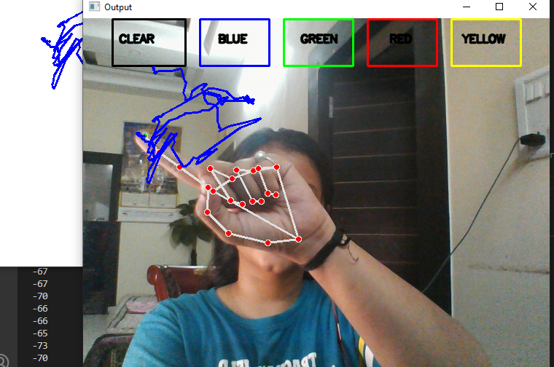
AI VIRTUAL BOARD
bpoints = [deque(maxlen=1024)]
blue_index = 0
paintWindow = np.zeros((471,636,3)) + 255
paintWindow = cv2.rectangle(paintWindow, (40,1), (140,65), (0,0,0), 2)
framergb = cv2.cvtColor(frame, cv2.COLOR_BGR2RGB)
lmx = int(lm.x * 640)
lmy = int(lm.y * 480

Slide 10
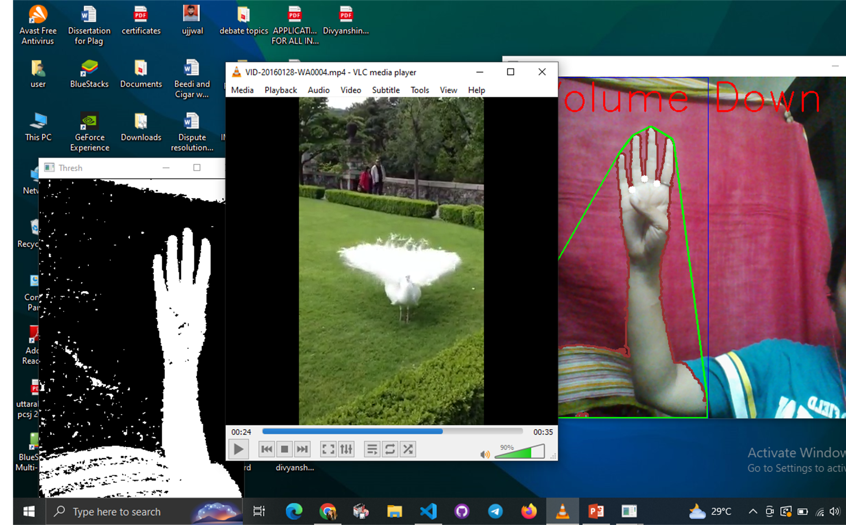

Slide 11
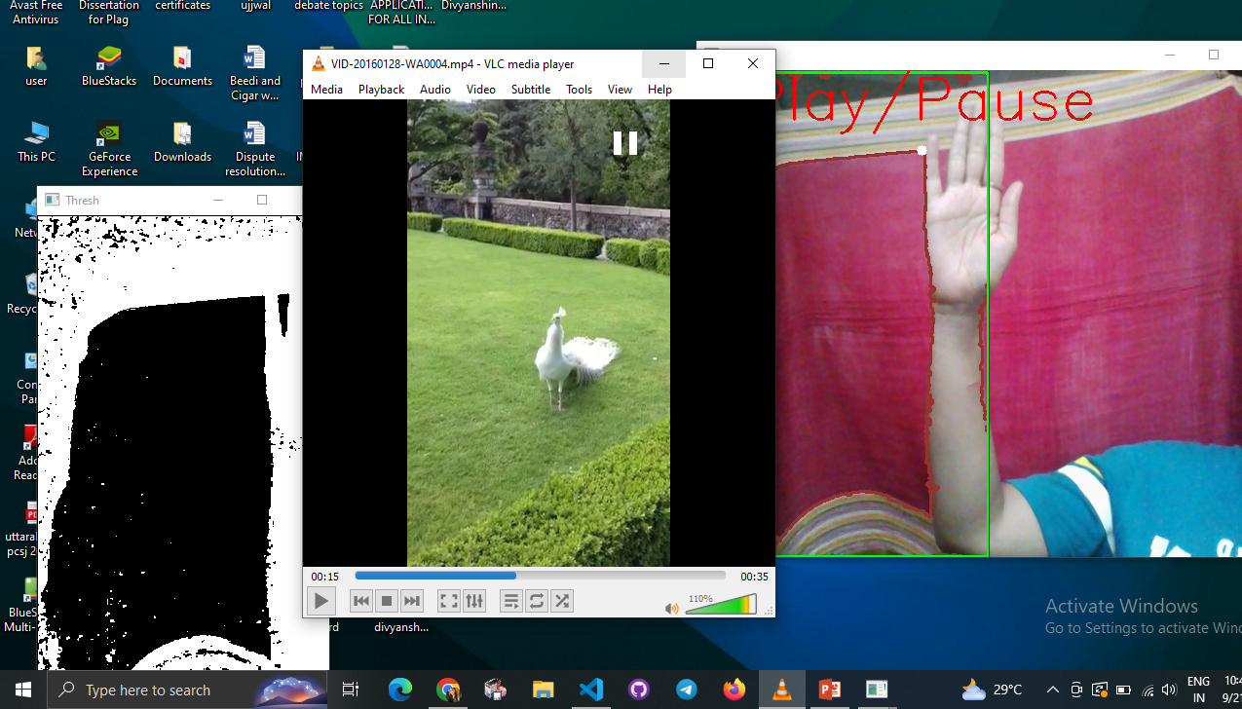

This presentation template is free for everyone to use thanks to the following:
SlidesCarnival for the presentation template
Pexels and Pixabay for the photos
Happy designing!

